Slide 1
Module 13: Neural Networks
Jurafsky and Martin Chapter 7

Slide 2
Logistic Regression
Jurafsky and Martin Chapter 5

Slide 3
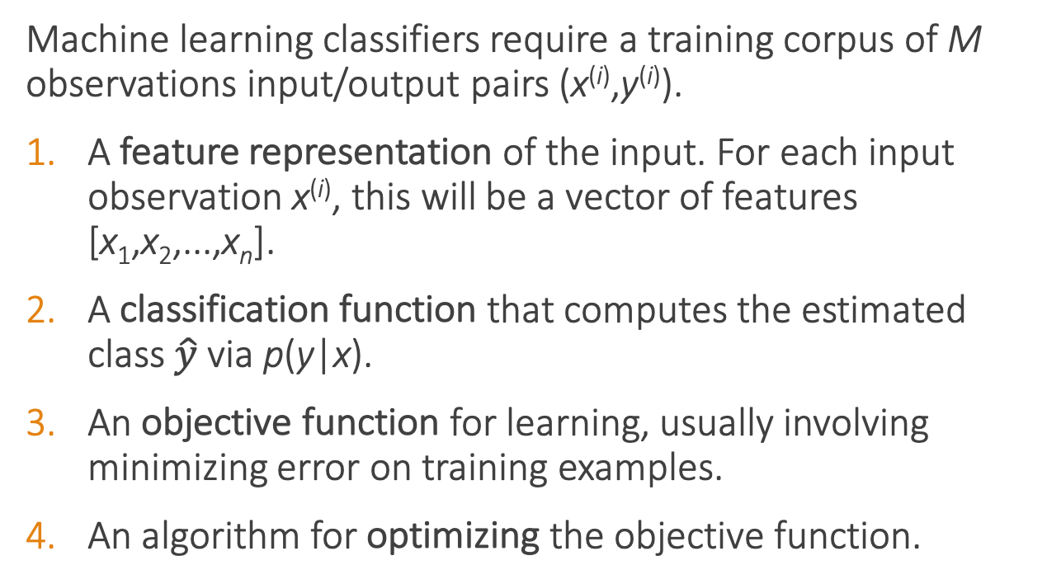
Classifier components
Machine learning classifiers require a training corpus of M observations input/output pairs (x^{(i)},y^{(i)}).
A feature representation of the input. For each input observation x^{(i)}, this will be a vector of features [x₁,x₂,...,x_{n}].
A classification function that computes the estimated class $\hat{y}$via p(y|x).
An objective function for learning, usually involving minimizing error on training examples.
An algorithm for optimizing the objective function.

Slide 4
Sentiment classifier
Input: "Spiraling away from narrative control as its first three episodes unreel, this series, about a post-apocalyptic future in which nearly everyone is blind, wastes the time of Jason Momoa and Alfre Woodard, among others, on a story that starts from a position of fun, giddy strangeness and drags itself forward at a lugubrious pace."
Output: positive (1) or negative (0)

Slide 5
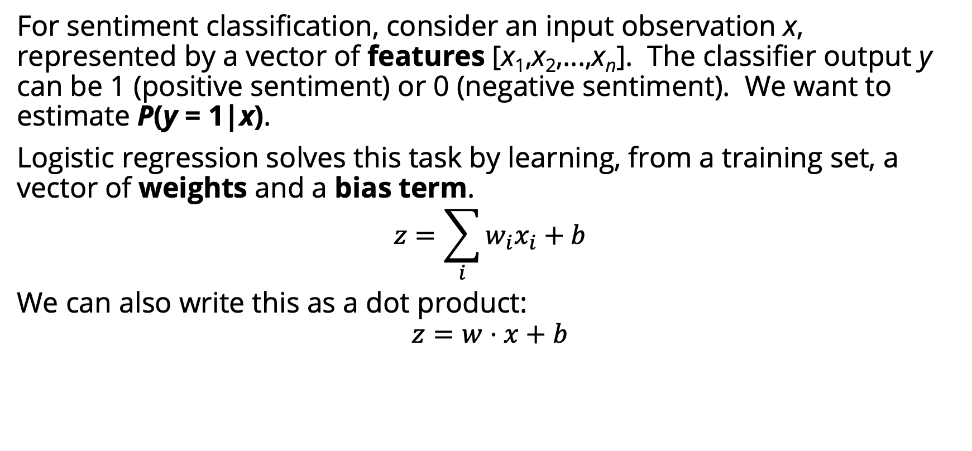
Sentiment classifier
For sentiment classification, consider an input observation x, represented by a vector of features [x₁,x₂,...,x_{n}]. The classifier output y can be 1 (positive sentiment) or 0 (negative sentiment). We want to estimate P(y = 1|x).
Logistic regression solves this task by learning, from a training set, a vector of weights and a bias term.
$$z=\sum_{i}{w_{i}x_{i}+b}$$
We can also write this as a dot product:
$$z=w⋅x+b$$
Notes:
The weight wi represents how important that input feature is to the classification decision, and can be positive (meaning the feature is associated with the class) or negative (meaning the feature is not associated with the class). Thus we might expect in a sentiment task the word awesome to have a high positive weight, and abysmal to have a very negative weight. The bias term, also called the intercept, is another real number that’s added to the weighted inputs.
But note that nothing forces z to be a legal probability, that is, to lie between 0 and 1. In fact, since weights are real-valued, the output might even be negative; z ranges from −∞ to ∞.

Slide 6
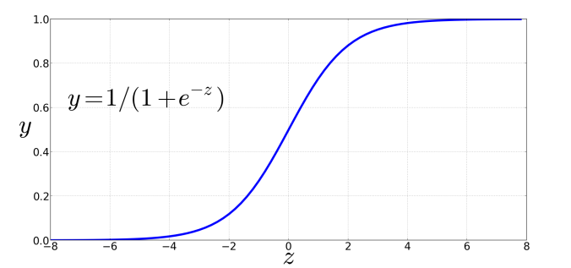
Sigmoid function
Notes:
But note that nothing forces z to be a legal probability, that is, to lie between 0 and 1. In fact, since weights are real-valued, the output might even be negative; z ranges from −∞ to ∞.
To create a probability, we’ll pass z through the sigmoid function, σ(z). The sigmoid function (named because it looks like an s) is also called the logistic func- tion, and gives logistic regression its name.

Slide 7
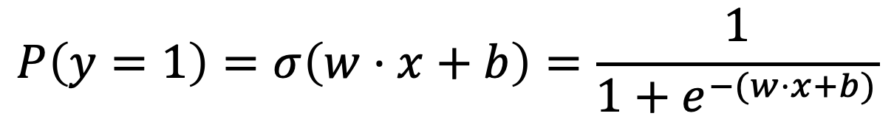
Probabilities
$$P\left(y=1\right)=σ\left(w⋅x+b\right)=\frac{1}{1+e^{−(w⋅x+b)}}$$

Slide 8
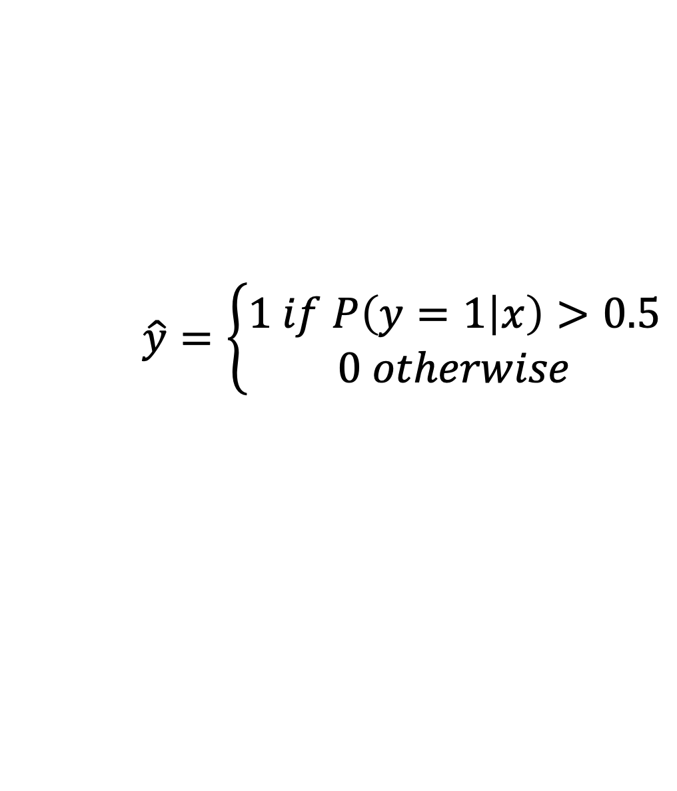
Decision boundary
Now we have an algorithm that given an instance x computes the probability P(y = 1|x). How do we make a decision?
For a test instance x, we say yes if the probability P(y = 1|x) is more than .5, and no otherwise. We call .5 the decision boundary
$$\hat{y}=\left\{\begin{aligned}1 if P\left(y=1 | x\right)>0.5 \\ 0 otherwise\end{aligned}\right.$$
Notes:
Now we have an algorithm that given an instance x computes the probability P(y = 1|x). How do we make a decision? For a test instance x, we say yes if the probability P(y = 1|x) is more than .5, and no otherwise. We call .5 the decision boundary

Slide 9
Extracting Features
It's hokey. There are virtually no surprises , and the writing is second-rate . So why was it so enjoyable? For one thing , the cast is great . Another nice touch is the music . I was overcome with the urge to get off the couch and start dancing . It sucked me in , and it'll do the same to you .
Var | Definition | Value
x₁ | Count of positive lexicon words
x₂ | Count of negative lexicon words
x₃ | Does no appear? (binary feature)
x₄ | Number of 1st and 2nd person pronouns
x₅ | Does ! appear? (binary feature)
x₆ | Log of the word count for the document

Slide 10
Extracting Features
It's hokey. There are virtually no surprises , and the writing is second-rate . So why was it so enjoyable? For one thing , the cast is great . Another nice touch is the music . I was overcome with the urge to get off the couch and start dancing . It sucked me in , and it'll do the same to you .
Var | Definition | Value
x₁ | Count of positive lexicon words | 3
x₂ | Count of negative lexicon words
x₃ | Does no appear? (binary feature)
x₄ | Number of 1st and 2nd person pronouns
x₅ | Does ! appear? (binary feature)
x₆ | Log of the word count for the document

Slide 11
Extracting Features
It's hokey. There are virtually no surprises , and the writing is second-rate . So why was it so enjoyable? For one thing , the cast is great . Another nice touch is the music . I was overcome with the urge to get off the couch and start dancing . It sucked me in , and it'll do the same to you .
Var | Definition | Value
x₁ | Count of positive lexicon words | 3
x₂ | Count of negative lexicon words | 2
x₃ | Does no appear? (binary feature)
x₄ | Number of 1st and 2nd person pronouns
x₅ | Does ! appear? (binary feature)
x₆ | Log of the word count for the document

Slide 12
Extracting Features
It's hokey. There are virtually no surprises , and the writing is second-rate . So why was it so enjoyable? For one thing , the cast is great . Another nice touch is the music . I was overcome with the urge to get off the couch and start dancing . It sucked me in , and it'll do the same to you .
Var | Definition | Value
x₁ | Count of positive lexicon words | 3
x₂ | Count of negative lexicon words | 2
x₃ | Does no appear? (binary feature) | 1
x₄ | Number of 1st and 2nd person pronouns
x₅ | Does ! appear? (binary feature)
x₆ | Log of the word count for the document

Slide 13
Extracting Features
It's hokey. There are virtually no surprises , and the writing is second-rate . So why was it so enjoyable? For one thing , the cast is great . Another nice touch is the music . I was overcome with the urge to get off the couch and start dancing . It sucked me in , and it'll do the same to you .
Var | Definition | Value
x₁ | Count of positive lexicon words | 3
x₂ | Count of negative lexicon words | 2
x₃ | Does no appear? (binary feature) | 1
x₄ | Number of 1st and 2nd person pronouns | 3
x₅ | Does ! appear? (binary feature)
x₆ | Log of the word count for the document

Slide 14
Extracting Features
It's hokey. There are virtually no surprises , and the writing is second-rate . So why was it so enjoyable? For one thing , the cast is great . Another nice touch is the music . I was overcome with the urge to get off the couch and start dancing . It sucked me in , and it'll do the same to you .
Var | Definition | Value
x₁ | Count of positive lexicon words | 3
x₂ | Count of negative lexicon words | 2
x₃ | Does no appear? (binary feature) | 1
x₄ | Number of 1st and 2nd person pronouns | 3
x₅ | Does ! appear? (binary feature) | 0
x₆ | Log of the word count for the document

Slide 15
Extracting Features
It's hokey. There are virtually no surprises , and the writing is second-rate . So why was it so enjoyable? For one thing , the cast is great . Another nice touch is the music . I was overcome with the urge to get off the couch and start dancing . It sucked me in , and it'll do the same to you .
Word count = 64, ln(64) = 4.15
Var | Definition | Value
x₁ | Count of positive lexicon words | 3
x₂ | Count of negative lexicon words | 2
x₃ | Does no appear? (binary feature) | 1
x₄ | Number of 1st and 2nd person pronouns | 3
x₅ | Does ! appear? (binary feature) | 0
x₆ | Log of the word count for the document | 4.15

Slide 16
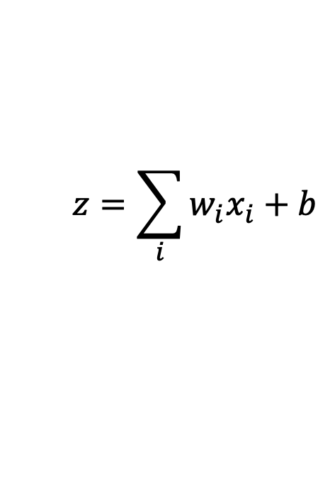
Var | Definition | Value | Weight | Product
x₁ | Count of positive lexicon words | 3 | 2.5
x₂ | Count of negative lexicon words | 2 | -5.0
x₃ | Does no appear? (binary feature) | 1 | -1.2
x₄ | Num 1st and 2nd person pronouns | 3 | 0.5
x₅ | Does ! appear? (binary feature) | 0 | 2.0
x₆ | Log of the word count for the doc | 4.15 | 0.7
b | bias | 1 | 0.1
$$z=\sum_{i}{w_{i}x_{i}+b}$$

Slide 17
Computing Z
Var | Definition | Value | Weight | Product
x₁ | Count of positive lexicon words | 3 | 2.5 | 7.5
x₂ | Count of negative lexicon words | 2 | -5.0 | -10
x₃ | Does no appear? (binary feature) | 1 | -1.2 | -1.2
x₄ | Num 1st and 2nd person pronouns | 3 | 0.5 | 1.5
x₅ | Does ! appear? (binary feature) | 0 | 2.0 | 0
x₆ | Log of the word count for the doc | 4.1 | 0.7 | 2.905
b | bias | 1 | 0.1 | 0.1
$$z=\sum_{i}{w_{i}x_{i}+b}$$
z=0.805

Slide 18
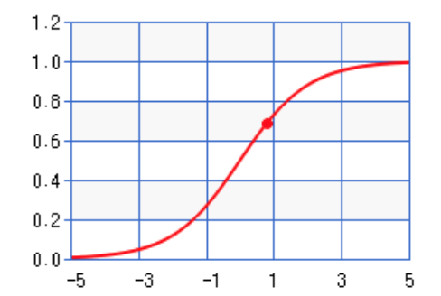
Sigmoid(Z)
Var | Definition | Value | Weight | Product
x₁ | Count of positive lexicon words | 3 | 2.5 | 7.5
x₂ | Count of negative lexicon words | 2 | -5.0 | -10
x₃ | Does no appear? (binary feature) | 1 | -1.2 | -1.2
x₄ | Num 1st and 2nd person pronouns | 3 | 0.5 | 1.5
x₅ | Does ! appear? (binary feature) | 0 | 2.0 | 0
x₆ | Log of the word count for the doc | 4.15 | 0.7 | 2.905
b | bias | 1 | 0.1 | 0.1
σ(0.805)=0.69
Notes:
So the probability that this is a positive review = 69%. The probability that it’s a negative review is 31%

Slide 19
Learning in logistic regression
How do we get the weights of the model? We learn the parameters (weights + bias) via learning. This requires 2 components:
An objective function or loss function that tells us distance between the system output and the gold output. We will use cross-entropy loss.
An algorithm for optimizing the objective function. We will use stochastic gradient descent to minimize the loss function.

Slide 20
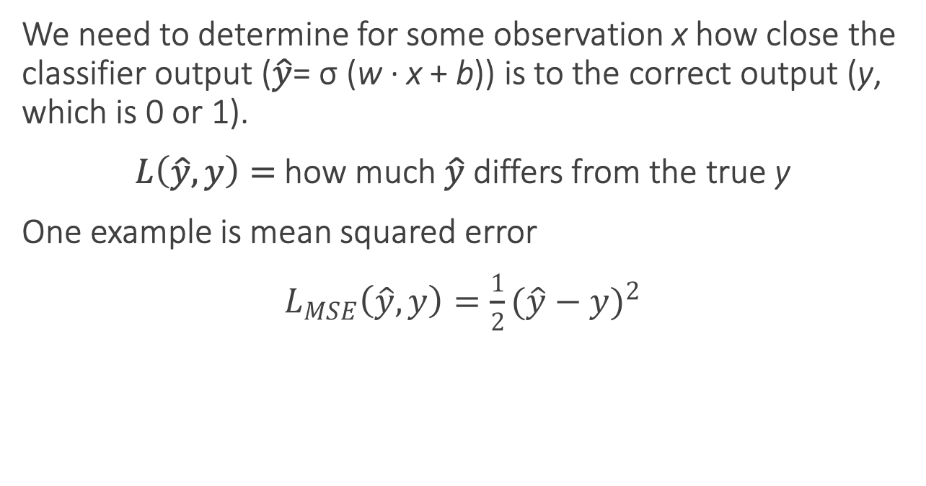
Loss functions
We need to determine for some observation x how close the classifier output ($\hat{y}$= σ (w · x + b)) is to the correct output (y, which is 0 or 1).
$L\left(\hat{y}, y\right)=$how much $\hat{y}$ differs from the true y
One example is mean squared error
$$L_{MSE}\left(\hat{y}, y\right)=\frac{1}{2}{(\hat{y}−y)}^{2}$$
Notes:
Mean Squared Error (MSE) is a common loss function used in regression problems, including many types of machine learning models. It measures the average of the squares of the errors or deviations—that is, the difference between the estimator and what is estimated.
Here's a breakdown of the :
L_{MSE}(y', y) = \frac{1}{2}(y' - y)^2
- L_{MSE}: This denotes the MSE loss function.
- y': This represents the predicted values output by the model.
- y: This is the actual value or the true target value.
- y' - y: This is the error or the difference between the predicted value and the actual value.
- (y' - y)^2: Squaring the error ensures that we are measuring the magnitude of the error irrespective of its direction (positive or negative). It penalizes larger errors more than smaller ones, which can be desirable in many situations.
- \frac{1}{2}: This term is often included as a constant multiplier to simplify the derivative of the function for optimization. It doesn't change the fundamental behavior of the loss function; it's mainly a mathematical convenience.
When you take the derivative of (y' - y)^2, you get 2(y' - y), and when the \frac{1}{2}from the MSE formula is multiplied by 2 from the derivative, they cancel each other out, which simplifies the process of finding the gradient during the training of the model.
The goal of training a model with MSE is to minimize this loss function; in other words, you want to adjust the model parameters so that your predicted values y’ are as close as possible to the actual values y. The 'mean' in MSE comes from taking the average of this squared error over all the samples in the dataset. The form you provided seems to omit the averaging part for simplicity or might be considering the case for a single data point
It turns out that this MSE loss, which is very useful for some algorithms like linear regression, becomes harder to optimize (technically, non-convex), when it’s applied to probabilistic classification.
https://towardsdatascience.com/why-not-mse-as-a-loss-function-for-logistic-regression-589816b5e03c

Slide 21
Loss functions for probabilistic classification
We use a loss function that prefers the correct class labels of the training example to be more likely.
Conditional maximum likelihood estimation: Choose parameters w, b that maximize the (log) probabilities of the true labels in the training data.
The resulting loss function is the negative log likelihood loss, more commonly called the cross entropy loss.

Slide 23
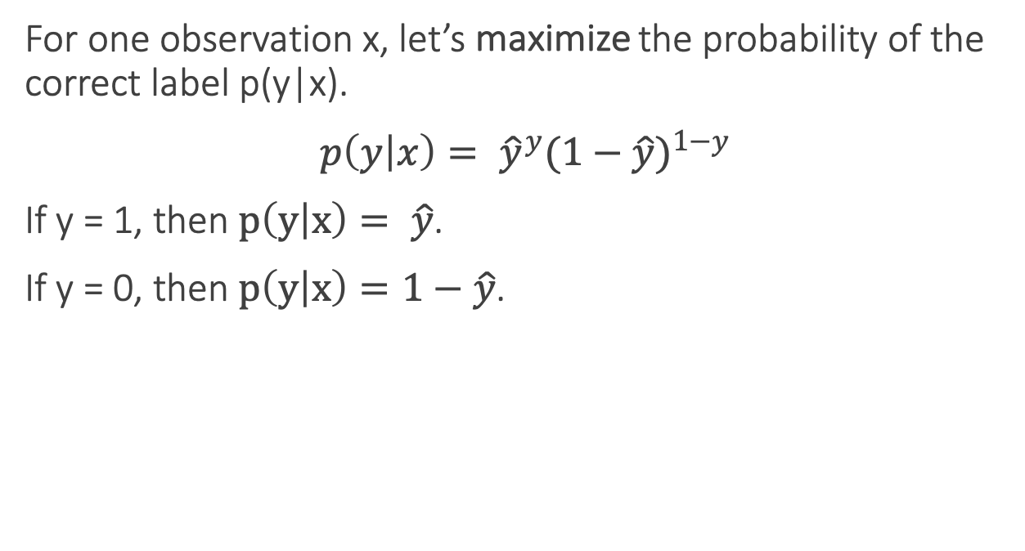
Loss functions for probabilistic classification
For one observation x, let’s maximize the probability of the correct label p(y|x).
$$p\left(y | x\right)= {\hat{y}}^{y}{(1−\hat{y})}^{1−y}$$
If y = 1, then $p\left(y | x\right)= \hat{y}$.
If y = 0, then $p\left(y | x\right)=1−\hat{y}$.

Slide 25
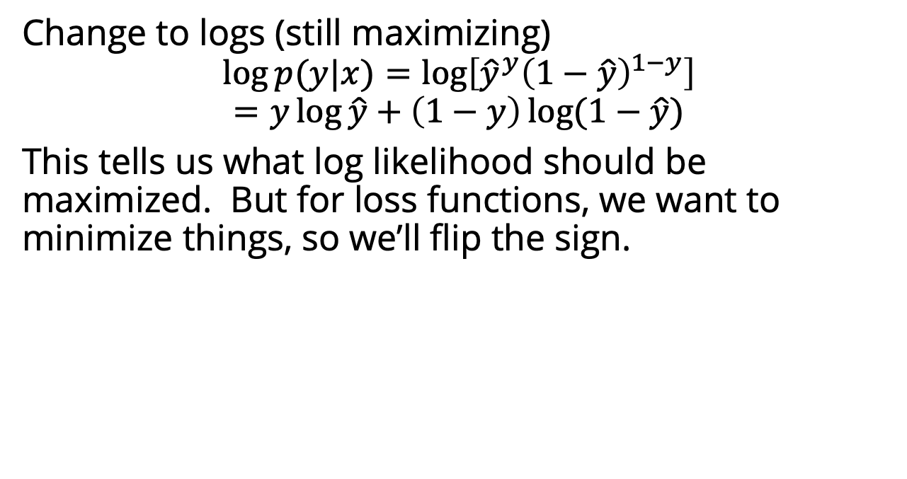
Loss functions for probabilistic classification
Change to logs (still maximizing)
$$\log{p(y|x)}=\log\left[{\hat{y}}^{y}{\left(1−\hat{y}\right)}^{1−y}\right]$$
$$=y\log{\hat{y}}+\left(1−y\right)\log{(1−\hat{y})}$$
This tells us what log likelihood should be maximized. But for loss functions, we want to minimize things, so we’ll flip the sign.

Slide 27
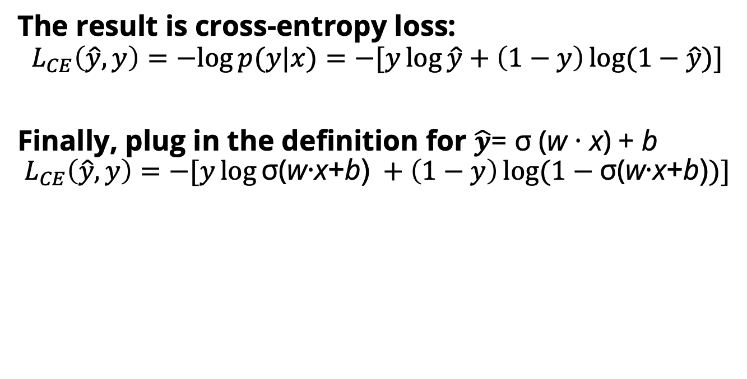
Cross-entropy loss
The result is cross-entropy loss:
$$L_{CE}\left(\hat{y}, y\right)=−log{p(y|x)}=−[y\log{\hat{y}}+\left(1−y\right)\log{(1−\hat{y})]}$$
Finally, plug in the definition for $\hat{y}$= σ (w · x) + b
$$L_{CE}\left(\hat{y}, y\right)=−[y\log{\text{σ}\text{(}\text{w}\text{·}\text{x}\text{+}\text{b}\text{)} }+\left(1−y\right)\log{(1−\text{σ}\text{(}\text{w}\text{·}\text{x}\text{+}\text{b}\text{)})]}$$
Notes:
In information theory, the cross entropy between two probability distributions p and q over the same underlying set of events measures the average number of bits needed to identify an event drawn from the set, if a coding scheme is used that is optimized for an "artificial" probability distribution q, rather than the "true" distribution p.
Information theoryEntropy
Differential entropy
Conditional entropy
Joint entropy
Mutual information
Conditional mutual information
Relative entropy
Entropy rate
Asymptotic equipartition property
Rate–distortion theory
Shannon's source coding theorem
Channel capacity
Noisy-channel coding theorem
Shannon–Hartley theorem
v

Slide 28
Cross-entropy loss
Why does minimizing this negative log probability do what we want? We want the loss to be smaller if the model’s estimate is close to correct, and we want the loss to be bigger if it is confused.
It's hokey. There are virtually no surprises , and the writing is second-rate . So why was it so enjoyable? For one thing , the cast is great . Another nice touch is the music . I was overcome with the urge to get off the couch and start dancing . It sucked me in , and it'll do the same to you .
P(sentiment=1|It’s hokey...) = 0.69. Let’s say y=1.
$$L_{CE}\left(\hat{y}, y\right)=−[y\log{\text{σ}\text{(}\text{w}\text{·}\text{x}\text{+}\text{b}\text{)} }+\left(1−y\right)\log{(1−\text{σ}\text{(}\text{w}\text{·}\text{x}\text{+}\text{b}\text{)})]}$$
$=−[\log{\text{σ}\text{(}\text{w}\text{·}\text{x}\text{+}\text{b}\text{)} }$]
$$=−\log{\text{(}\text{0.69}\text{)}=0.37}$$
Notes:
This loss function also ensures that as probability of the correct answer is maximized, the probability of the incorrect answer is minimized; since the two sum to one, any increase in the probability of the correct answer is coming at the expense of the incorrect answer.

Slide 29
Cross-entropy loss
Why does minimizing this negative log probability do what we want? We want the loss to be smaller if the model’s estimate is close to correct, and we want the loss to be bigger if it is confused.
It's hokey. There are virtually no surprises , and the writing is second-rate . So why was it so enjoyable? For one thing , the cast is great . Another nice touch is the music . I was overcome with the urge to get off the couch and start dancing . It sucked me in , and it'll do the same to you .
P(sentiment=1|It’s hokey...) = 0.69. Let’s pretend y=0.
$$L_{CE}\left(\hat{y}, y\right)=−[y\log{\text{σ}\text{(}\text{w}\text{·}\text{x}\text{+}\text{b}\text{)} }+\left(1−y\right)\log{(1−\text{σ}\text{(}\text{w}\text{·}\text{x}\text{+}\text{b}\text{)})]}$$
$= −[log(1−{\text{σ}\text{(}\text{w}\text{·}\text{x}\text{+}\text{b}\text{)}\text{)} }$]
$$= −\log{\text{(}\text{0.31}\text{)}=1.17}$$
Notes:
This loss function also ensures that as probability of the correct answer is maximized, the probability of the incorrect answer is minimized; since the two sum to one, any increase in the probability of the correct answer is coming at the expense of the incorrect answer.

Slide 30
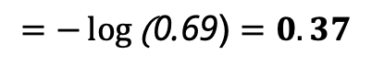
Cross-entropy loss
Why does minimizing this negative log probability do what we want? We want the loss to be smaller if the model’s estimate is close to correct, and we want the loss to be bigger if it is confused.
It's hokey. There are virtually no surprises , and the writing is second-rate . So why was it so enjoyable? For one thing , the cast is great . Another nice touch is the music . I was overcome with the urge to get off the couch and start dancing . It sucked me in , and it'll do the same to you .
If our prediction is correct, then our CE loss is lower
If our prediction is incorrect, then our CE loss is higher
$$=−\log{\text{(}\text{0.69}\text{)}=0.37}$$
$−\log{\text{(}\text{0.31}\text{)}=1.17}$
Notes:
Why does minimizing this negative log probability do what we want? A per- fect classifier would assign probability 1 to the correct outcome (y=1 or y=0) and probability 0 to the incorrect outcome. That means the higher yˆ (the closer it is to 1), the better the classifier; the lower yˆ is (the closer it is to 0), the worse the clas- sifier. The negative log of this probability is a convenient loss metric since it goes from 0 (negative log of 1, no loss) to infinity (negative log of 0, infinite loss). This loss function also ensures that as the probability of the correct answer is maximized, the probability of the incorrect answer is minimized; since the two sum to one, any increase in the probability of the correct answer is coming at the expense of the in- correct answer.

Slide 31
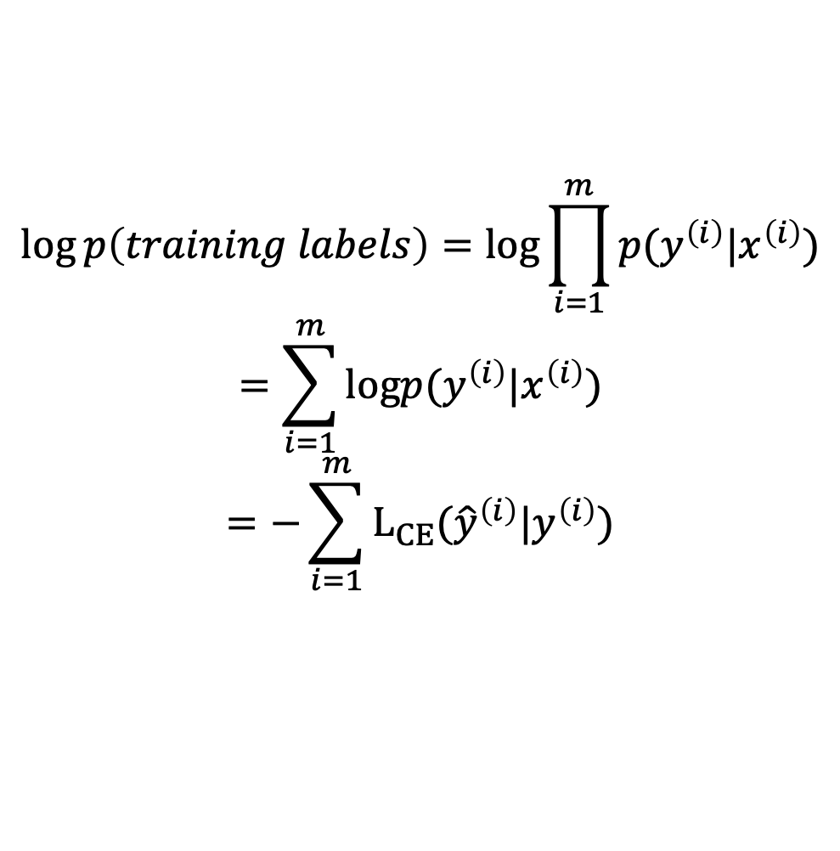
Loss on all training examples
$$\log{p\left(training labels\right)=log\prod_{i=1}^{m}{p(y^{\left(i\right)}|x^{\left(i\right)})}}$$
$$=\sum_{i=1}^{m}{logp(y^{\left(i\right)}|x^{\left(i\right)})}$$
$$=−\sum_{i=1}^{m}{L_{CE}({\hat{y}}^{\left(i\right)}|y^{\left(i\right)})}$$

Slide 32
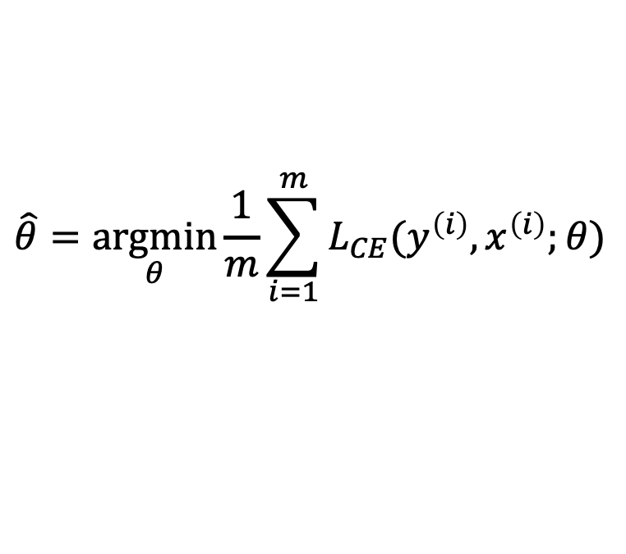
Finding good parameters
We use gradient descent to find good settings for our weights and bias by minimizing the loss function.
Gradient descent is a method that finds a minimum of a function by figuring out in which direction (in the space of the parameters θ) the function’s slope is rising the most steeply, and moving in the opposite direction.
$$\hat{θ}=\underset{θ}{argmin}{\frac{1}{m}\sum_{i=1}^{m}{L_{CE}(y^{\left(i\right)},x^{\left(i\right)};θ)}}$$
Notes:
Our goal with gradient descent is to find the optimal weights: minimize the loss function we’ve defined for the model. In Eq. 5.16 below, we’ll explicitly represent the fact that the loss function L is parameterized by the weights, which we’ll refer to in machine learning in general as θ (in the case of logistic regression θ = w, b)

Slide 33
Gradient descent
Notes:
The intuition is that if you are skiing in a canyon and trying to descend most quickly down to the river at the bottom, you might look around yourself 360 degrees, find the direction where the ground is sloping the steepest, and godownhill in that direction.

Slide 34
Global v. Local Minimums
For logistic regression, this loss function is conveniently convex.
A convex function has just one minimum, so there are no local minima to get stuck in.
So gradient descent starting from any point is guaranteed to find the minimum.
Notes:
By contrast, the loss for multi-layer neural networks is non-convex, and gradient descent may get stuck in local minima for neural network training and never find the global optimum

Slide 36
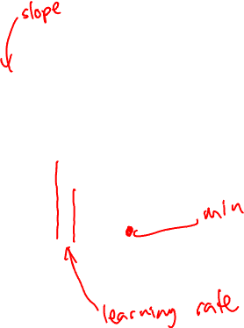
Iteratively find minimum
Notes:
The gradient descent algorithm answers this question by finding the gradient of the loss function at the current point and moving in the opposite direction. The gradient of a function of many variables is a vector pointing in the direction the greatest increase in a function. The gradient is a multi-variable generalization of the slope, so for a function of one variable like the one in Fig. 5.3, we can informally think of the gradient as the slope. The dotted line in Fig. 5.3 shows the slope of this hypothetical loss function at point w = w1. You can see that the slope of this dotted line is negative. Thus to find the minimum, gradient descent tells us to go in the opposite direction: moving w in a positive direction.
The first step in iteratively finding the minimum of this loss function, by moving w in the reverse direction from the slope of the function. Since the slope is negative, we need to move w in a positive direction, to the right. Here superscripts are used for learning steps, so w1 means the initial value of w (which is 0), w2 at the second step, and so on.

Slide 38
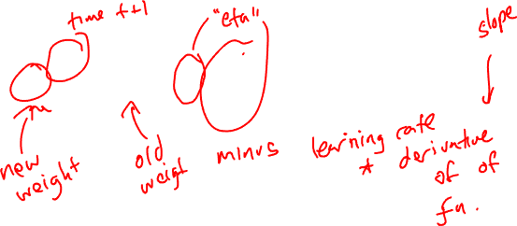
How much should we update the parameter by?
The magnitude of the amount to move in gradient descent is the value of the slope weighted by a learning rate η.
A higher/faster learning rate means that we should move w more on each step.
Notes:
η = eta. Is the learning rate
The change we make in our parameter is the
learning rate times the gradient (or the slope, in our single-variable example)
In each dimension wi, we express the slope as a partial derivative ∂ of the loss ∂wi
function with respect to the weight.
The magnitude of the amount to move in gradient descent is the value of the slope d f (x; w) weighted by a learning rate η . A higher (faster) learning rate means that
dw we should move w more on each step. The change we make in our parameter is the
learning rate times the gradient (or the slope, in our single-variable example):

Slide 39
Stochastic Gradient Descent
No lecture on Thursday. I will be traveling for a grant kick-off meeting.
Jurafsky and Martin Chapter 5

Slide 40
Gradient descent
Notes:
The intuition is that if you are skiing in a canyon and trying to descend most quickly down to the river at the bottom, you might look around yourself 360 degrees, find the direction where the ground is sloping the steepest, and godownhill in that direction.

Slide 41
Many dimensions
Notes:
Now let’s extend the intuition from a function of one scalar variable w to many variables, because we don’t just want to move left or right, we want to know where in the N-dimensional space (of the N parameters that make up θ ) we should move. The gradient is just such a vector; it expresses the directional components of the sharpest slope along each of those N dimensions. If we’re just imagining two weight dimension (say for one weight w and one bias b), the gradient might be a vector with two orthogonal components, each of which tells us how much the ground slopes in the w dimension and in the b dimension.
In an actual logistic regression, the parameter vector w is much longer than 1 or 2, since the input feature vector x can be quite long, and we need a weight wi for each xi For each dimension/variable wi in w (plus the bias b), the gradient will have a component that tells us the slope with respect to that variable. Essentially we’re asking: “How much would a small change in that variable wi influence the total loss function L?”

Slide 43
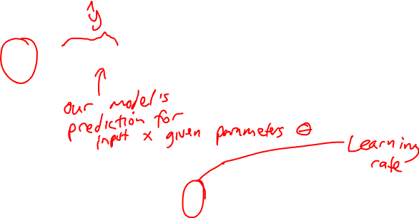
Updating each dimension w_{i}
The final equation for updating θ based on the gradient is
Notes:
In an actual logistic regression, the parameter vector w is much longer than 1 or 2, since the input feature vector x can be quite long, and we need a weight wi for each xi For each dimension/variable wi in w (plus the bias b), the gradient will have a component that tells us the slope with respect to that variable. Essentially we’re asking: “How much would a small change in that variable wi influence the total loss function L?”
In each dimension wi, we express the slope as a partial derivative ∂ of the loss ∂wi function with respect to that parameter wi.
The gradient is then defined as a vector of these partials. We’ll represent yˆ as f (x; θ ) to make the dependence on θ more obvious.
∇: Del, or nabla, is an operator used in mathematics, in particular in vector calculus, as a vector differential operator, usually represented by the nabla symbol ∇.

Slide 45
The Gradient
To update θ, we need a definition for the gradient ∇L( f (x; θ ), y).
For logistic regression, the cross-entropy loss function is:
The derivative of this function for one observation vector x for a single weight w_{j} is
The gradient is a very intuitive value: the difference between the true y and our estimate for x, multiplied by the corresponding input value x_{j} .
Notes:
Note in Eq. 5.17 that the gradient with respect to a single weight w j represents a very intuitive value: the difference between the true y and our estimated yˆ = σ (w · x + b) for that observation, multiplied by the corresponding input value x j .

Slide 46
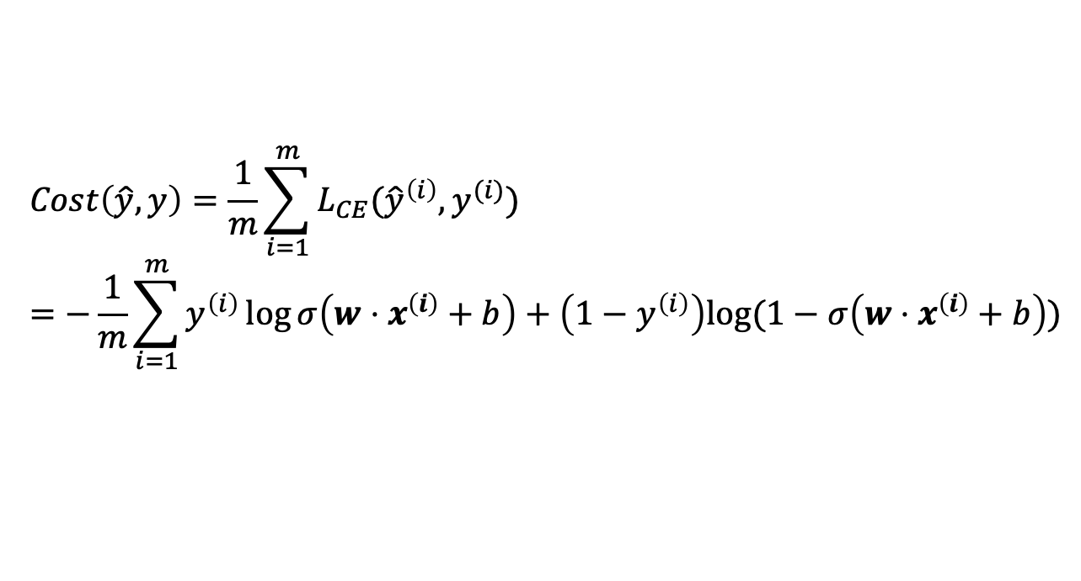
Average Loss
$$Cost\left(\hat{y}, y\right)=\frac{1}{m}\sum_{i=1}^{m}{L_{CE}({\hat{y}}^{\left(i\right)},y^{(i)}})$$
$$=−\frac{1}{m}\sum_{i=1}^{m}{y^{\left(i\right)}\log{σ\left(w⋅x^{\left(i\right)}+b\right)}+\left(1−y^{\left(i\right)}\right)log⁡(1−σ\left(w⋅x^{\left(i\right)}+b\right))}$$
This is what we want to minimize!!

Slide 47
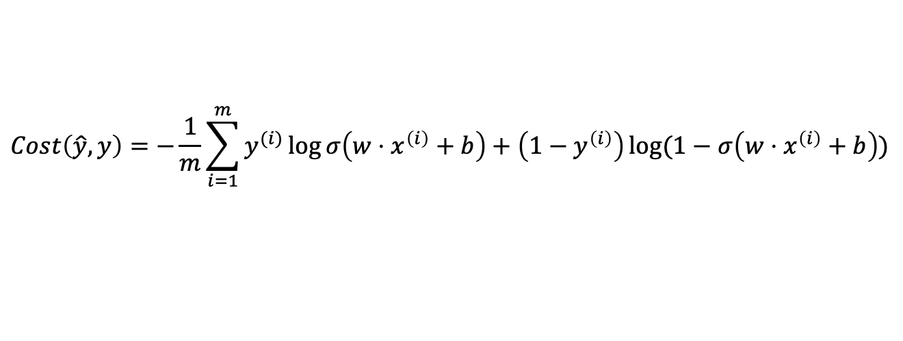
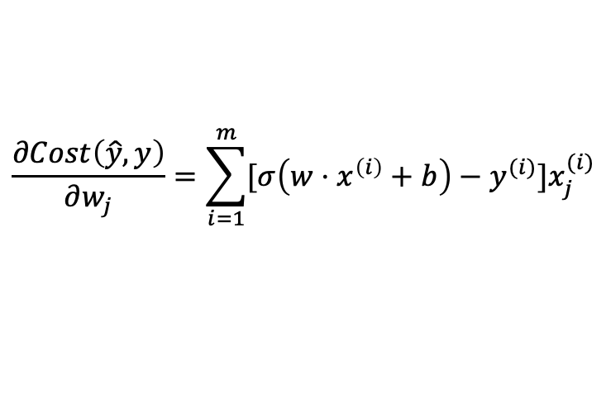
Batch Training
The loss for a batch of data or an entire dataset is just the average loss over the m examples
The gradient for multiple data points is the sum of the individual gradients:
$$Cost\left(\hat{y}, y\right)=−\frac{1}{m}\sum_{i=1}^{m}{y^{(i)}\log{σ\left(w⋅x^{\left(i\right)}+b\right)+\left(1−y^{\left(i\right)}\right)\log{(1−σ\left(w⋅x^{\left(i\right)}+b\right))}}}$$
$$\frac{∂Cost\left(\hat{y}, y\right)}{∂w_{j}}=\sum_{i=1}^{m}{[σ\left(w⋅x^{\left(i\right)}+b\right)−y^{(i)}}]x_{j}^{(i)}$$
Notes:
Now the cost function for the mini-batch of m examples is the average loss for each example.
The mini-batch gradient is the average of the individual gradients

Slide 48
Stochastic gradient descent algorithm
Notes:
Stochastic gradient descent is an online algorithm that minimizes the loss function by computing its gradient after each training example, and nudging θ in the right direction (the opposite direction of the gradient).
Stochastic gradient descent is called stochastic because it chooses a single random example at a time, moving the weights so as to improve performance on that single example. That can result in very choppy movements, so it’s also common to do minibatch gradient descent, which computes the gradient over batches of train- ing instances rather than a single instance.
The stochastic gradient descent algorithm. Step 1 (computing the loss) is used to report how well we are doing on the current tuple. The algorithm can terminate when it converges (or when the gradient < ε), or when progress halts (for example when the loss starts going up on a held-out set).
The learning rate η is a parameter that must be adjusted. If it’s too high, the learner will take steps that are too large, overshooting the minimum of the loss func- tion. If it’s too low, the learner will take steps that are too small, and take too long to get to the minimum. It is most common to begin the learning rate at a higher value, and then slowly decrease it, so that it is a function of the iteration k of training; you will sometimes see the notation ηk to mean the value of the learning rate at iteration k.

Slide 49
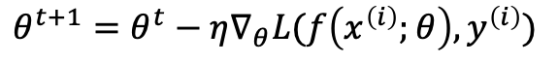
Worked example
Let’s walk though a single step of the gradient descent algorithm. We’ll use a simple sentiment classifier with just 2 features, and 1 training instance where the correct value is y = 1 (this is a positive review).
x₁ = 3 (count of positive lexicon words)
x₂ = 2 (count of negative lexicon words)
The initial weights and bias in θ⁰ are all set to 0, and the initial learning rate η is 0.1:
w₁ = w₂ = b = 0
η = 0.1
The single update step requires that we compute the gradient, multiplied by the learning rate:
$$θ^{t+1}=θ^{t}−η∇_{θ}L(f\left(x^{\left(i\right)};θ\right),y^{\left(i\right)})$$
Notes:
todo – add the worked example from textbook sectino 5.4.3

Slide 51
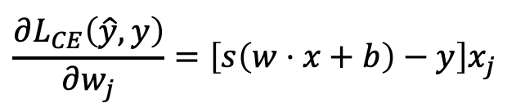
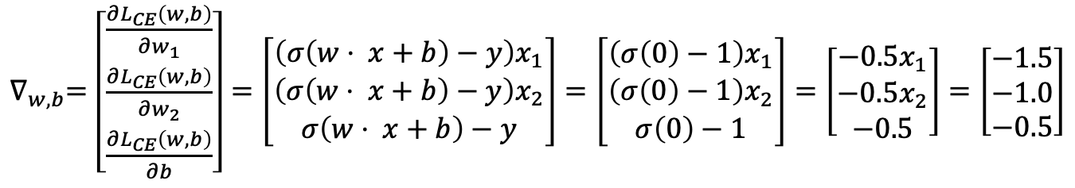
Worked example
The derivative of this function for a single training example x for a single weight w_{j} is
The gradient vector has 3 dimensions, for w₁, w₂, and b. For our input, x₁ = 3 and x₂ = 2
x₂ = 2
$$\frac{∂L_{CE}\left(\hat{y}, y\right)}{∂w_{j}}=\left[s\left(w⋅x+b\right)−y\right]x_{j}$$
$∇_{w,b}=$ $\left[\begin{matrix}\frac{∂L_{CE}\left(w,b\right)}{∂w_{1}} \\ \frac{∂L_{CE}\left(w,b\right)}{∂w_{2}} \\ \frac{∂L_{CE}\left(w,b\right)}{∂b}\end{matrix}\right]=\left[\begin{matrix}\left(σ\left(w⋅ x+b\right)−y\right)x_{1} \\ \left(σ\left(w⋅ x+b\right)−y\right)x_{2} \\ σ\left(w⋅ x+b\right)−y\end{matrix}\right]=\left[\begin{matrix}\left(σ\left(0\right)−1\right)x_{1} \\ \left(σ\left(0\right)−1\right)x_{2} \\ σ\left(0\right)−1\end{matrix}\right]=\left[\begin{matrix}−0.5x_{1} \\ −0.5x_{2} \\ −0.5\end{matrix}\right]=\left[\begin{matrix}−1.5 \\ −1.0 \\ −0.5\end{matrix}\right]$
Notes:
todo – add the worked example from textbook sectino 5.4.3

Slide 53
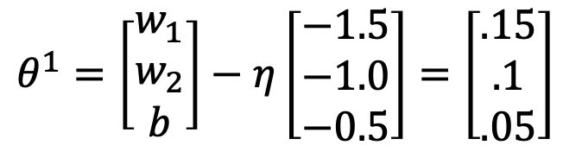
Worked example
Now that we have a gradient ∇_{w,b} , we compute the new parameter vector θ¹ by moving θ⁰ in the opposite direction from the gradient:
So after one step of gradient descent, the weights have shifted to be:
w₁ = 0.15, w₂ = 0.1, and b= .05
$$θ^{1}=\left[\begin{matrix}w_{1} \\ w_{2} \\ b\end{matrix}\right]−η\left[\begin{matrix}−1.5 \\ −1.0 \\ −0.5\end{matrix}\right]=\left[\begin{matrix}.15 \\ .1 \\ .05\end{matrix}\right]$$
Notes:
Note that this observation x happened to be a positive example. We would expect that after seeing more negative examples with high counts of negative words, that the weight w2 would shift to have a negative value.

Slide 54
Mini-batch training
Stochastic gradient descent chooses a single random example at a time and updates its weights on that example. As a result, the updates can fluctuate.
An alternate is batch training, which computes the gradient over the entire dataset. This gives a much better estimate of which direction to move the weights but takes a long time to compute.
A commonly used compromise is mini-batch training, where we train on a small batch. The batch size can be 512 or 1024, often selected based on computational resources, so that all examples in the mini-batch can be processed in parallel. The loss is then accumulated.

Slide 55
Regularization
Overfitting is a problem with many machine learning models. Overfitting results in poor generalization and poor performance on unseen test set.
In logistic regression, if a feature only occurs in one class then it will get a high weight. Sometimes we are just modelling noisy factors that just accidentally correlate with the class.
Regularization is a way to penalize large weights. A regularization term is added to the loss function.
Lasso regression uses L1 regularization Ridge regression uses L2 regularization
Notes:
There is a problem with learning weights that make the model perfectly match the training data. If a feature is perfectly predictive of the outcome because it happens to only occur in one class, it will be assigned a very high weight. The weights for features will attempt to perfectly fit details of the training set, in fact too perfectly, modeling noisy factors that just accid
entally correlate with the class. This problem is called overfitting.
L1 regularization is a linear function of the weight values, named after the L1 norm, the sum of the absolute values of the weights, or Manhattan distance
L2 regularization is a quadratic function of the weight values, named because it uses the (square of the) L2 norm of the weight values. The L2 norm, ||θ||2, is the same as the Euclidean distance of the vector θ from the origin.
L2 regularization is easier to optimize because of its simple derivative, while L1 regularization is more complex (the derivative is non-continuous at zero).

Slide 56
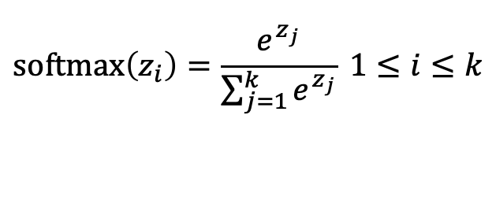
Multinomial logistic regression
Instead of binary classification, we often want more than two classes. For sentiment classification we might extend the class labels to be positive, negative, and neutral.
We want to know the probability of y for each class c ∈ C, p(y = c|x).
To get a proper probability, we will use a generalization of the sigmoid function called the softmax function.
$$\text{softmax}\left(z_{i}\right)=\frac{e^{z_{j}}}{\sum_{j=1}^{k}{e^{z_{j}}}} 1≤i≤k$$
Notes:
In such cases we use multinomial logistic regression, also called softmax re- gression (or, historically, the maxent classifier).
The softmax function takes a vector z = [z1,z2,...,zk] of k arbitrary values and maps them to a probability distribution, with each value in the range (0,1), and all the values summing to 1. Like the sigmoid, it is an exponential function.

Slide 57
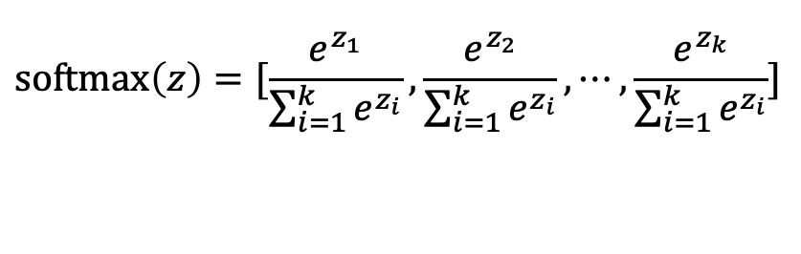
Softmax
The softmax function takes in an input vector z = [z₁,z₂,...,z_{k}] and outputs a vector of values normalized into probabilities.
For example, for this input:
z = [0.6, 1.1, −1.5, 1.2, 3.2, −1.1]
Softmax will output:
[0.056, 0.090, 0.007, 0.099, 0.74, 0.010]
$$\text{softmax}\left(z\right)=[\frac{e^{z_{1}}}{\sum_{i=1}^{k}{e^{z_{i}}}},\frac{e^{z_{2}}}{\sum_{i=1}^{k}{e^{z_{i}}}},⋯,\frac{e^{z_{k}}}{\sum_{i=1}^{k}{e^{z_{i}}}}]$$
Notes:
0.6+1.1 −1.5+1.2+3.2−1.1 = 3.5
0.054+0.090+0.007+0.099+0.74+0.010 = 1
5th one has the highest probability

Slide 58
Neural Networks
Jurafsky and Martin Chapter 7

Slide 59
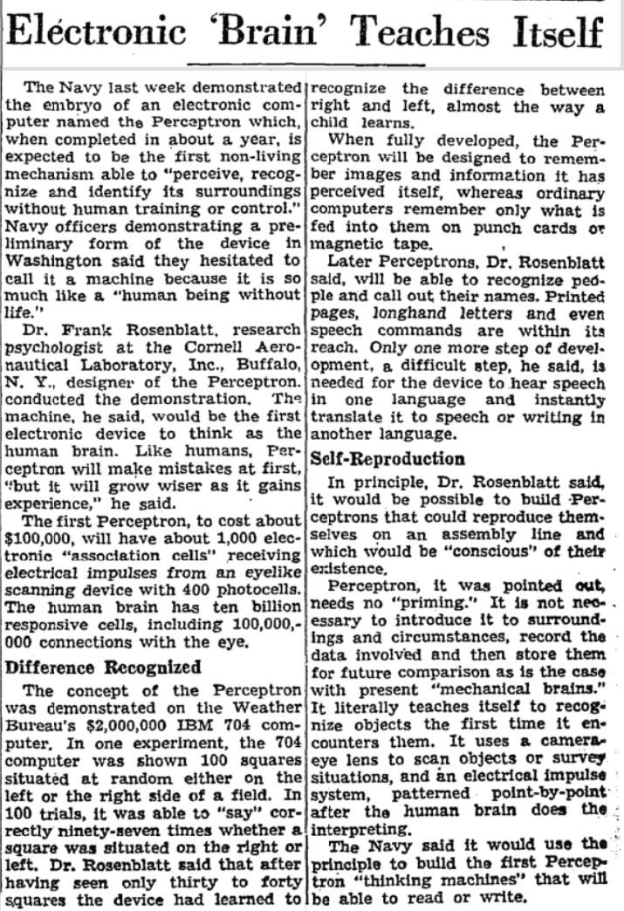
Review: Perceptron
Perceptrons were developed in the 1950s and 1960s loosely inspired by the neuron.
Notes:
New York Times - July 13, 1958 “Electronic 'Brain' Teaches Itself”
The Navy last week demonstrated the embryo of an electronic computer named the Perceptron which, when completed in about a year, is expected to be the first non-living mechanism able to "perceive, recognize and identify its surroundings without human training or control."

Slide 60
Neural Networks
The building block of a neural network is a single computational unit. A unit takes a set of real valued numbers as input, performs some computation.

Slide 61
Neural Networks: A brain-inspired metaphor

Slide 62
A single neuron
Notes:
As the name suggests, neural networks were inspired by the brain’s computation mechanism, which consists of computation units called neurons. While the connections between artificial neural networks and the brain are in fact rather slim, we repeat the metaphor here for complete- ness. In the metaphor, a neuron is a computational unit that has scalar inputs and outputs. Each input has an associated weight. e neuron multiplies each input by its weight, and then sums1 them, applies a nonlinear function to the result, and passes it to its output. Figure 4.1 shows such a neuron.

Slide 63
Neural networks
Notes:
The neurons are connected to each other, forming a network: the output of a neuron may feed into the inputs of one or more neurons. Such networks were shown to be very capable computational devices. If the weights are set correctly, a neural network with enough neurons and a nonlinear activation function can approximate a very wide range of mathematical functions (we will be more precise about this later).
A typical feed-forward neural network may be drawn as shown. Each circle is a neuron, with incoming arrows being the neuron’s inputs and outgoing arrows being the neuron’s outputs. Each arrow carries a weight, reflecting its importance (not shown). Neurons are arranged in layers, reflecting the flow of information. The bottom layer has no incoming arrows, and is
the input to the network. the top-most layer has no outgoing arrows, and is the output of the network. The other layers are considered “hidden.” thee sigmoid shape inside the neurons in the middle layers represent a nonlinear function (i.e., the logistic function) that is applied to the neuron’s value before passing it to the output. In the figure, each neuron is connected to all of the neurons in the next layer—this is called a fully connected layer or an affine layer.

Slide 64
Perceptron -> Logistic Regression
Like the Perceptron, logistic regression uses a vector of weights and a bias term.
$$z=\sum_{i}{w_{i}x_{i}+b}$$
This can also be written as a dot product:
$$z=w⋅x+b$$
Instead of outputting z directly, logistic regression transforms it with the sigmoid function σ(z).

Slide 65
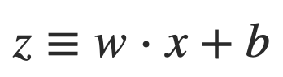
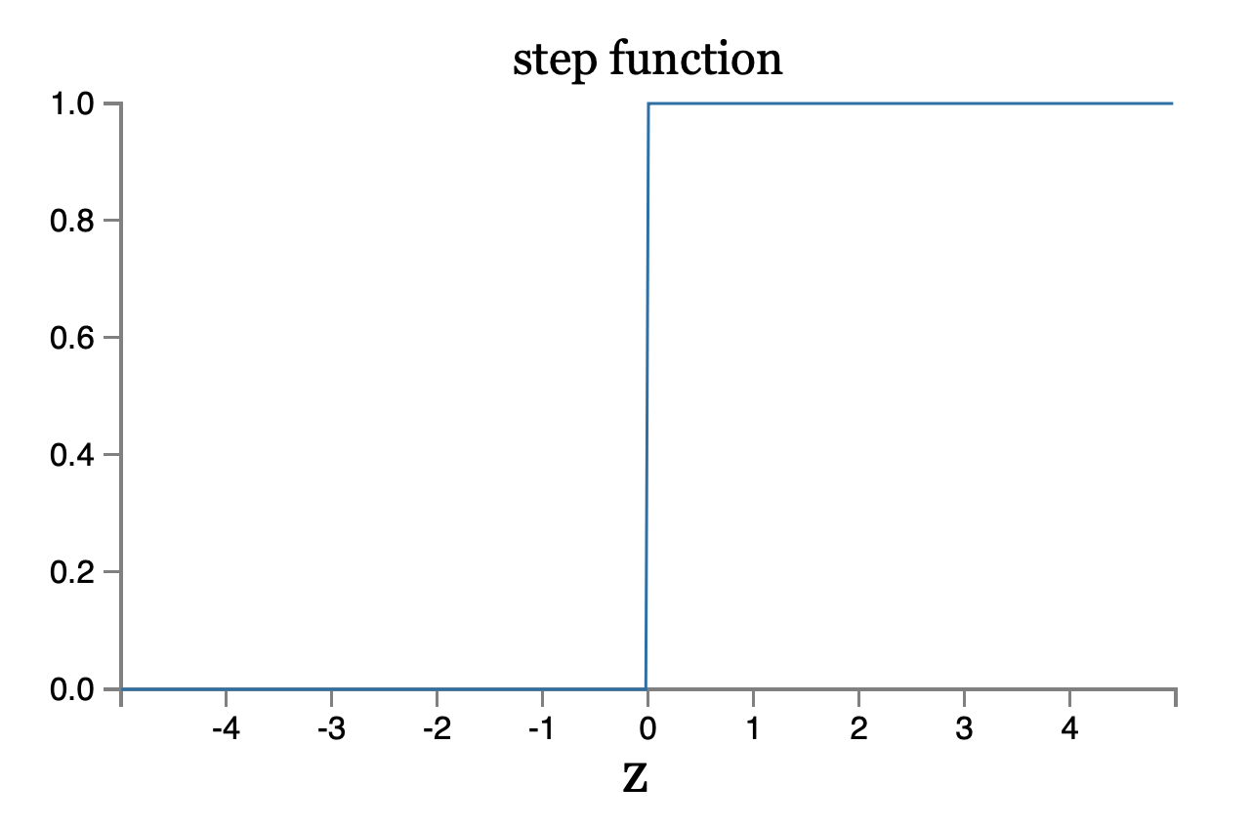
Perceptron

Slide 66
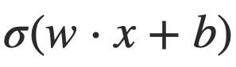
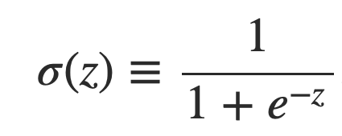
Sigmoid neurons
Problem: a small change in the weights or bias of any single perceptron in the network can causes the output to completely flip from 0 to 1.
Solution: sigmoid neuron
Perceptron
Sigmoid neuron
output =
Output is no longer just 1 or 0.
Same weights and bias as perceptron
Sigmoid function:
Inputs: any real-valued number
Notes:
That flip may then cause the behavior of the whole network to change in a very complicated way.

Slide 67
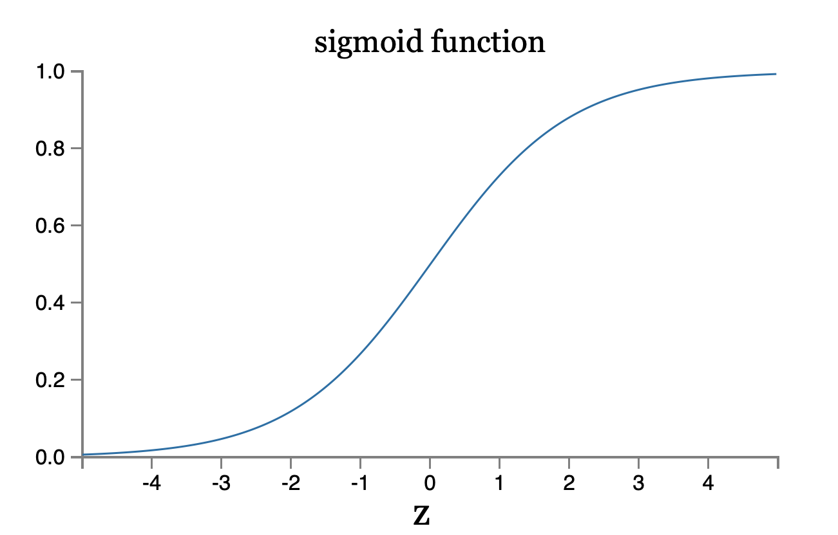
Sigmoid neuron
Notes:
To understand the similarity to the perceptron model, suppose z≡w⋅x+bz≡w⋅x+b is a large positive number. Then e^−z≈00 and so σ(z)≈1. In other words, when z=w⋅x+b is large and positive, the output from the sigmoid neuron is approximately 1, just as it would have been for a perceptron. Suppose on the other hand that z=w⋅x+b is very negative. Then e^−z→∞, and σ(z)≈00. So when z=w⋅x+b is very negative, the behavior of a sigmoid neuron also closely approximates a perceptron. It's only when w⋅x+b is of modest size that there's much deviation from the perceptron model.

Slide 68
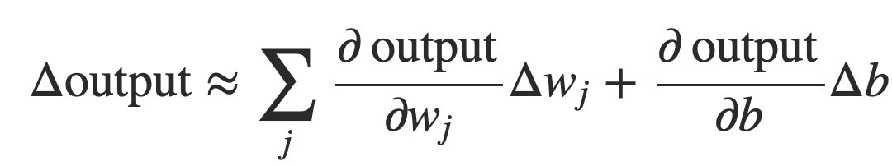
Smoothness is crucial
Smoothness of σ means that small changes in the weights w_{j} and in the bias b will produce a small change the output from the neuron
Δoutput is a linear function of the changes Δwj and Δb
This makes it easy to choose small changes in the weights and biases to achieve any desired small change in the output
Notes:
where the sum is over all the weights, wj and bias b and ∂output/∂wj is the partial derivative of the output with respect to wj. And ∂output/∂b denote partial derivative of the output with respect b.
This linearity makes it easy to choose small changes in the weights and biases to achieve any desired small change in the output. So while sigmoid neurons have much of the same qualitative behaviour as perceptrons, they make it much easier to figure out how changing the weights and biases will change the output.

Slide 69
Activation Functions
Instead of directly outputting z = w·x+b, which is a linear function of x, neuron units apply a non-linear function f to z.
The output of this function is called the activation value for the unit, represented by the variable a. The output of a neural network is called y, so if the activation of a node is the final output of a network then
y=a= f(z)
There are 3 commonly used non-linear functions used for f: The sigmoid function The tanh function The rectified linear unit ReLU
The sigmoid function

Slide 70
Activation Functions
The sigmoid function
tanh
ReLU
Notes:
These activation functions have different properties that make them useful for differ- ent language applications or network architectures. For example the rectifier func- tion has nice properties that result from it being very close to linear. In the sigmoid or tanh functions, very high values of z result in values of y that are saturated, i.e., extremely close to 1, which causes problems for learning. Rectifiers don’t have this problem, since the output of values close to 1 also approaches 1 in a nice gentle linear way. By contrast, the tanh function has the nice properties of being smoothly differentiable and mapping outlier values toward the mean.
In practice, the sigmoid is not commonly used as an activation function.

Slide 71
Feed-Forward Neural Network
The simplest kind of NN is the Feed-Forward Neural Network
Multilayer network, all units are usually fully-connected, and no cycles.
The outputs from each layer are passed to units in the next higher layer, and no outputs are passed back to lower layers.
Layer 2 (output layer)
Layer 1 (hidden layer)
Layer 0 (input layer)
Notes:
We’ll introduce networks with cycles, called recurrent neural networks Later. For historical reasons multilayer networks, especially feedforward networks, are sometimes called multi-layer perceptrons (or MLPs); this is a technical misnomer, since the units in modern multilayer networks aren’t perceptrons (perceptrons are purely linear, but modern networks are made up of units with non-linearities like sigmoids), but at some point the name stuck.
The core of the neural network is the hidden layer formed of hidden units, each of which is a neural unit, taking a weighted sum of its inputs and then applying a non-linearity. In the standard architecture, each layer is fully-connected, meaning that each unit in each layer takes as input the outputs from all the units in the previous layer, and there is a link between every pair of units from two adjacent layers. Thus each hidden unit sums over all the input units.

Slide 72
Equations for a feedforward network
A single hidden unit has parameters w (the weight vector) and b (the bias scalar).
We represent the parameters for the entire hidden layer by combining the weight vector w_{i} and bias b_{i} for each unit i into a single weight matrix W and a single bias vector b for the whole layer.
Notes:
Each element Wi j of the weight matrix W represents the weight of the connection from the ith input unit xi to the jth hidden unit hj.

Slide 73
Equations for a feedforward network
The advantage of using a single matrix W for the weights of the entire layer is the hidden layer computation can be done efficiently with simple matrix operations.
The computation has three steps:
1. multiplying the weight matrix by the input vector x, 2. adding the bias vector b, and 3. applying the activation function g (such as Sigmoid)
The output of the hidden layer, the vector h, is thus the following, using the sigmoid function σ:
h = σ(Wx+b)
Notes:
Notice that we’re applying the σ function here to a vector, while previously it was applied to a scalar. We’re thus allowing σ(·), and indeed any activation function g(·), to apply to a vector element-wise, so g[z1,z2,z3] = [g(z1),g(z2),g(z3)].

Slide 74
Equations for a feedforward network
Like the hidden layer, the output layer has a weight matrix U. Its weight matrix is multiplied by its input vector (h) to produce the intermediate output z.
z=Uh
Notes:
Each element Wi j of the weight matrix W represents the weight of the connection from the ith input unit xi to the jth hidden unit hj.

Slide 75
Equations for a feedforward network
Here are the final equations for a feedforward network with a single hidden layer, which takes an input vector x, outputs a probability distribution y, and is parameterized by weight matrices W and U and a bias vector b:
h = σ(Wx+b) z = Uh y = softmax(z)
Like with logistic regression, softmax normalizes the output and turns it into a probability distribution.
Notes:
Notice that we’re applying the σ function here to a vector, while previously it was applied to a scalar. We’re thus allowing σ(·), and indeed any activation function g(·), to apply to a vector element-wise, so g[z1,z2,z3] = [g(z1),g(z2),g(z3)].

Slide 76
Training Neural Nets
Like logistic regression, we want to learn the best parameters for the neural net to make its predictions $\hat{y}$ as close to possible as the gold standard labels in our training data y.
What do we need?
A loss function – cross-entropy loss
An optimization algorithm – gradient descent
A way of computing the gradient of the loss function – error propagation
Notes:
gradient descent requires knowing the gradient of the loss function, the vector that contains the partial derivative of the loss function with respect to each of the parameters. Here is one part where learning for neural networks is more complex than for logistic logistic regression. In logistic regression, for each observation we could directly compute the derivative of the loss function with respect to an individual w or b. But for neural networks, with millions of parameters in many layers, it’s much harder to see how to compute the partial derivative of some weight in layer 1 when the loss is attached to some much later layer. How do we partial out the loss over all those intermediate layers?
The answer is the algorithm called error backpropagation or reverse differentiation.

Slide 77
Cross-Entropy Loss
If the neural network is a binary classifier with a sigmoid at the final layer, the loss function is exactly the same as we saw in logistic regression:
$$LCE\left(\hat{y}, y\right)=−log p\left(y | x\right){=−[y\log{\hat{y}+\left(1 −y\right)\log{(1 − \hat{y}})]}}$$
Notes:
K in the denominator is the number of classes.

Slide 78
Cross-Entropy Loss
If the neural network is a binary classifier with a sigmoid at the final layer, the loss function is exactly the same as we saw in logistic regression:
$$LCE\left(\hat{y}, y\right)=−log p\left(y | x\right){=−[y\log{\hat{y}+\left(1 −y\right)\log{(1 − \hat{y}})]}}$$
For multinomial classification
$LCE\left(\hat{y}, y\right)= − \sum_{i=1}^{C}{yi\log{\hat{yi}} }$
If there is only one correct answer, where the truth is y_{i}=1, then this simplifies to be
$$LCE\left(\hat{y}, y\right)= −\log{\hat{yi}}$$
Plugging into softmax:
$$LCE\left(\hat{y}, y\right)= −\log{\frac{e^{zi}}{\sum_{j=1}^{K}{e^{zj}}}}$$
Notes:
K in the denominator is the number of classes.

Slide 79
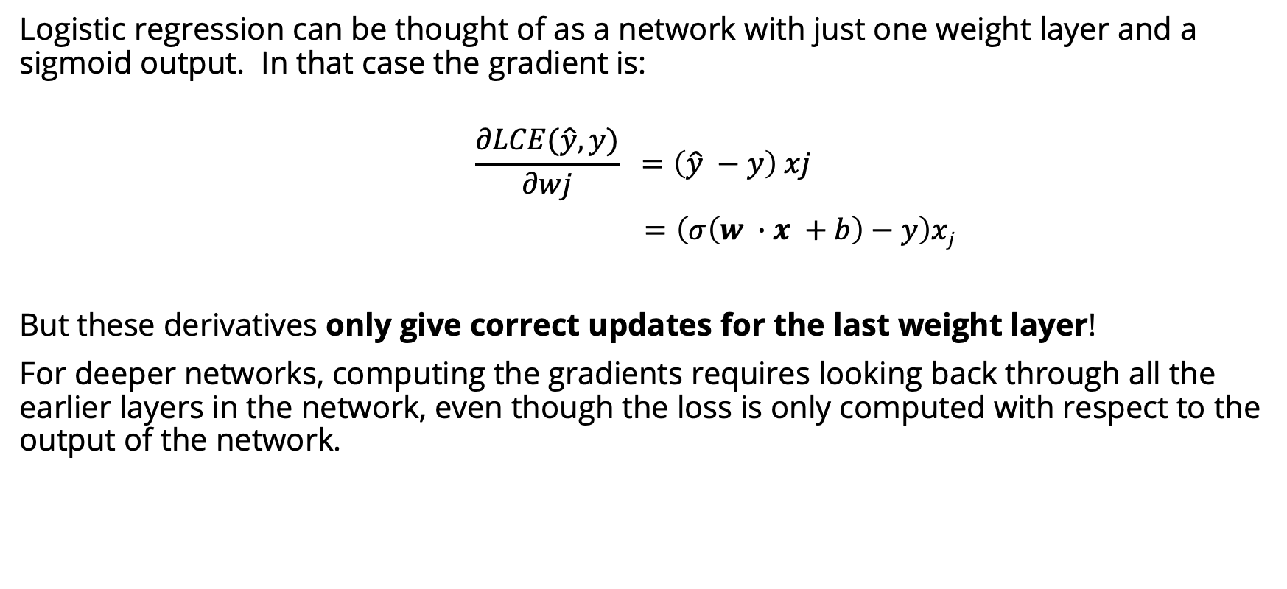
Computing the gradient
Logistic regression can be thought of as a network with just one weight layer and a sigmoid output. In that case the gradient is:
$$\frac{∂LCE(\hat{y}, y)}{∂wj} =\left(\hat{y} −y\right) xj$$
$=\left(σ\left(w ∙x +b\right)−y\right)xj$
But these derivatives only give correct updates for the last weight layer!
For deeper networks, computing the gradients requires looking back through all the earlier layers in the network, even though the loss is only computed with respect to the output of the network.
Solution: error backpropagation algorithm

Slide 80
Computation Graphs
Although backpropagation was invented for neural nets, it is related to general procedure called backward differentiation, which depends on the notion of computation graphs.
A computation graph represents the process of computing a mathematical expression. The computation is broken down into separate operations. Each operation is a node in a graph.
L(a, b, c) = c(a + 2b)
d = 2∗b
e = a+d
L = c∗e
Notes:
If we make each of the component addition and multiplication operations explicit, and add names (d and e) for the intermediate outputs, the resulting series of computations.

Slide 81
Forward pass
L(a, b, c) = c(a + 2b)
d = 2∗b
e = a+d
L = c∗e
inputs a = 3, b = 1, c = −2,
Notes:
We can now represent this as a graph, with nodes for each operation, and directed edges showing the outputs from each operation as the inputs to the next, The simplest use of computation graphs is to compute the value of the function with some given inputs. For inputs a = 3, b = 1, c = −2, and we’ve shown the result of the forward pass to compute the result L(3, 1, −2) = 10. In the forward pass of a computation graph, we apply each operation left to right, passing the outputs of each computation as the input to the next node.

Slide 82
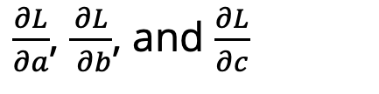
Backward differentiation
The importance of the computation graph comes from the backward pass, which is used to compute the derivatives that we’ll need for the weight update.
How do we compute the derivative of our output function L with respect to the input variables a, b, and c?
Backwards differentiation uses the chain rule from calculus.
$\frac{∂L}{∂a}$, $\frac{∂L}{ ∂b}$, and $\frac{∂L}{∂c}$
Notes:
The importance of the computation graph comes from the backward pass, which is used to compute the derivatives that we’ll need for the weight update. In this example our goal is to compute the derivative of the output function L with respect to each of the input variables, i.e., ∂L/∂a ∂L/∂b , and
∂L/∂c .
The derivative ∂L/∂a , tells us how much a small change in a affects L.

Slide 83
Chain rule
For a composite function f(x) = u(v(x)), the derivative of f(x) is:
Similarly for, f(x) = u(v(w(x))), the derivative of f(x) is:
$$\frac{df}{dx}=\frac{du}{dv} ∙\frac{dv}{dx}$$
$$\frac{df}{dx}=\frac{du}{dv} ∙\frac{dv}{dw}∙\frac{dw}{dx}$$
Notes:
Suppose we are computing the derivative of a composite function f (x) = u(v(x)). The derivative of f (x) is the derivative of u(x) with respect to v(x) times the derivative of v(x) with respect to x.

Slide 84
$$\frac{∂L}{∂c}=e$$
Notes:
Let’s now compute the 3 derivatives we need. Since in the computation graph L = ce, we can directly compute the derivative ∂L/∂c For the other two, we’ll need to use the chain rule. thus requires five intermediate derivatives. the derivative of a sum is the sum of the derivatives.

Slide 85
$$\frac{∂L}{∂a}=\frac{∂L}{∂e}\frac{∂e}{∂a}$$
$$\frac{∂L}{∂b}=\frac{∂L}{∂e}\frac{∂e}{∂d}\frac{∂d}{∂b}$$
$$\frac{∂L}{∂c}=e$$
Notes:
Let’s now compute the 3 derivatives we need. Since in the computation graph L = ce, we can directly compute the derivative ∂L/∂c For the other two, we’ll need to use the chain rule. thus requires five intermediate derivatives. the derivative of a sum is the sum of the derivatives.

Slide 86
$$\frac{∂L}{∂a}=\frac{∂L}{∂e}\frac{∂e}{∂a}$$
$$\frac{∂e}{∂a}=1,\frac{∂e}{∂d}=1$$
$$\frac{∂L}{∂b}=\frac{∂L}{∂e}\frac{∂e}{∂d}\frac{∂d}{∂b}$$
$$\frac{∂d}{∂b}=2$$
$$\frac{∂L}{∂e}=c, \frac{∂L}{∂c}=e$$
$$\frac{∂L}{∂c}=e$$
Notes:
Let’s now compute the 3 derivatives we need. Since in the computation graph L = ce, we can directly compute the derivative ∂L/∂c For the other two, we’ll need to use the chain rule. thus requires five intermediate derivatives. the derivative of a sum is the sum of the derivatives.

Slide 87
Backward pass
Notes:
In the backward pass, we compute each of these partials along each edge of the graph from right to left, multiplying the necessary partials to result in the final derivative we need. Thus we begin by annotating the final node with ∂ L /∂ L = 1. Moving to the ∂L left, we then compute ∂ L/∂ c and ∂ L/∂ e , and so on, until we have annotated the graph all the way to the input variables. The forward pass conveniently already will have computed the values of the forward intermediate variables we need (like d and e) to compute these derivatives. In this figure, At each node we need to compute the local partial derivative with respect to the parent, multiply it by the partial derivative that is being passed down from the parent, and then pass it to the child.

Slide 88
Computation Graph for a NN
$$z^{[1]}=W^{[1]} x+b^{[1]} \\ a^{[1]}=ReLU\left(z^{\left[1\right]}\right) \\ z^{[2]}=W^{[2]}a^{[1]}+b^{[2]} \\ a^{[2]}=σ\left(z^{\left[2\right]}\right)$$
$\hat{ y}=$ $a^{[2]}$
Notes:
This shows a sample computation graph for a 2-layer neural network with layers of sizen0 = 2, n1 = 2, and n2 = 1. Assuming binary classification and hence using a sigmoid output unit for simplicity. The function that the computation graph is computing is: given by these equations in the lower right.
he weights that need updating (those for which we need to know the partial derivative of the loss function) are shown in orange. In order to do the backward pass, we’ll need to know the derivatives of all the functions in the graph. The derivative of the sigmoid σ :
dσ(z)/dz = σ(z)(1−σ(z))

Slide 89
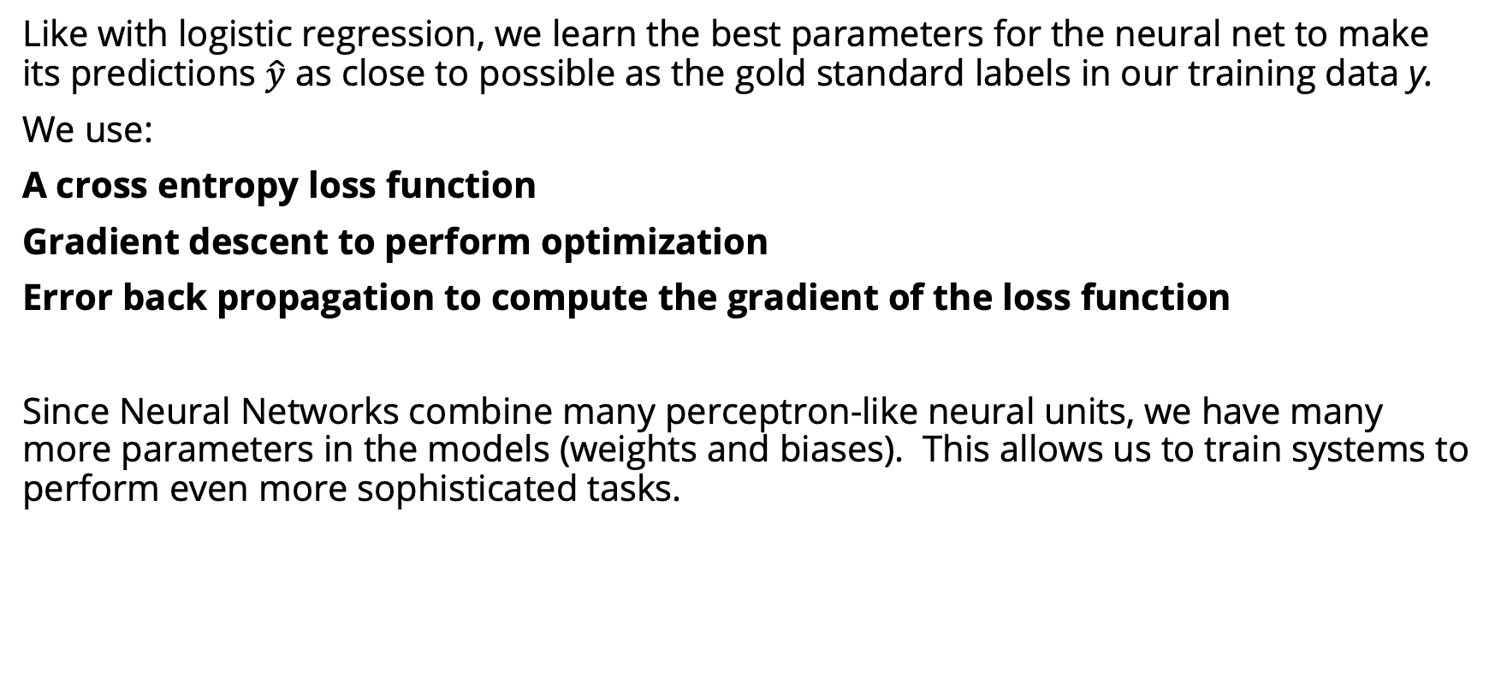
Summary
Like with logistic regression, we learn the best parameters for the neural net to make its predictions $\hat{y}$ as close to possible as the gold standard labels in our training data y.
We use:
A cross entropy loss function
Gradient descent to perform optimization
Error back propagation to compute the gradient of the loss function
Since Neural Networks combine many perceptron-like neural units, we have many more parameters in the models (weights and biases). This allows us to train systems to perform even more sophisticated tasks.
Notes:
K in the denominator is the number of classes.

Slide 90
Next time: Neural Language Models

